Slide 1

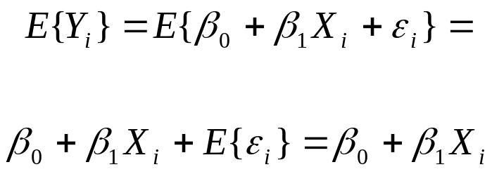
Simple Linear Regression
The response Y_{i} is the sum of two parts: (1) the constant term β₀ + β₁X_{i} and (2) the random term ε_{i}.
Thus Y_{i} is a random variable.
Since E{ε_{i}} = 0 and β₀ + β₁X_{i} is a constant term, we have that

Slide 2

Simple Linear Regression
The regression function for the model is then
where the regression function relates the means of the probability distribution of Y for a given level of X to the level of X.
The response Y_{i} in the i^{th} trial exceeds or falls short of the value in the regression function by the error term amount ε_{i}

Slide 3
Simple Linear Regression
The error terms ε_{i} are assumed to have a constant variance σ². Thus
since the variance of a constant is 0.
Thus, this regression model assumes that the probability distributions of Y for a given value of X, have the same variance σ², regardless of the level of X.

Slide 4
Simple Linear Regression
The error terms are assumed to be uncorrelated. Since the error terms are uncorrelated, so are the responses.
Therefore, the outcome in any one trial has no effect on the responses for any other trial.
Summary: For this regression model, the responses Y_{i} come from a probability distributions whose
means are E{Y_{i}) = β₀ + β₁X_{i}
variances are σ², the same for all levels of X
and any two responses Y_{i} and Y_{j} are uncorrelated.

Slide 5
Simple Linear Regression
For example, suppose an electrical distributor is studying the relationship between the number of bids for lighting equipment during a week and the time required to prepare the bids.
So the response is the time to prepare the bids and the predictor is the number of bids.
The regression model is
Y_{i} = 9.5 + 2.1 X_{i} + ε_{i}
Suppose that in the i^{th} week, 45 bids are prepared and the actual number of hours required Y_{i} is 108. What is the value of ε_{i}?

Slide 6
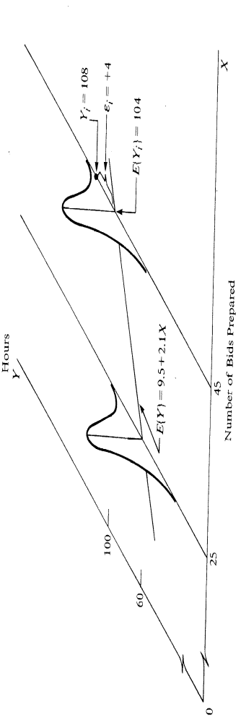
Simple Linear Regression
E{Y_{i}}=9.5+2.1 X_{i} = 9.5 + 2.1(45) = 104.
We observed Y_{i} = 108. Thus the error is 4 and ε_{i}=4.
The below figure contains the regression function E{Y}=9.5+2.1X

Slide 7
Simple Linear Regression
The figure displays the probability distribution of Y when X=45 and indicates from where in this distribution the observation Y_{i}=108 came.
The error term ε_{i}=4 is the deviation of Y_{i} from E{Y_{i}}, the regression line.

Slide 8
Simple Linear Regression
The figure also displays the probability distribution of Y when X=25.
The distribution of Y given X=25 has the same variability as the probability distribution of Y given X=45.

Slide 9
Meaning of regression parameters
The parameters β₀ and β₁ are called regression coefficients.
β₁ is the slope of the regression line.
It indicates the change in E{Y} per unit increase in X.
β₀ is the intercept of the regression line and gives the value of E{Y} when X=0.

Slide 10
Estimation of regression function
For each trial, there is an X observation and a Y observation. For the i^{th} trial, we denote these observations as (X_{i},Y_{i}), i=1,2,…n.
To find “good” estimators of the regression parameters, we use the method of least squares.
For the observations (X_{i},Y_{i}), the method of least squares utilizes the deviation of Y_{i} from E{Y_{i}}, where here again E{Y_{i}} = (β₀ + β₁ X_{i}).
Thus for simple linear regression, the deviations are:
Y_{i} – (β₀ + β₁ X_{i})

Slide 11
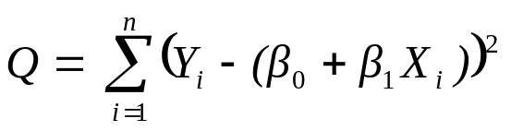
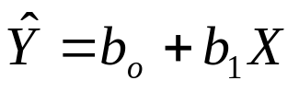
Estimation of regression function
Denote Q as the sum of the n squared deviations such that
For the method of least squares, the estimators of β₀ and β₁ are the values of β₀ and β₁ that minimize the value of Q for the data.
The estimators of β₀ and β₁ are denoted by b₀ and b₁.
For a value of X, an estimated value of E{Y} is denoted as Y(hat) and we have:

Slide 12

Estimation of regression function
Consider an example where we are interested in the relationship between age and persistence.
Three subjects are given a difficult task and their age and number of attempts to complete the task before giving up was recorded.
Now suppose we create an arbitrary regression line
In Class: For this arbitrary regression line, calculate Q.
Subject i: | 1 | 2 | 3
Age | 20 | 55 | 30
Number of attempts | 5 | 12 | 10

Slide 13
Estimation of regression function
For the first subject the deviation is
Y₁-(b₀ + b₁X₁) = 5 – (9 + 0*20) = -4.
The sum of the squared deviations, Q, is

Slide 14
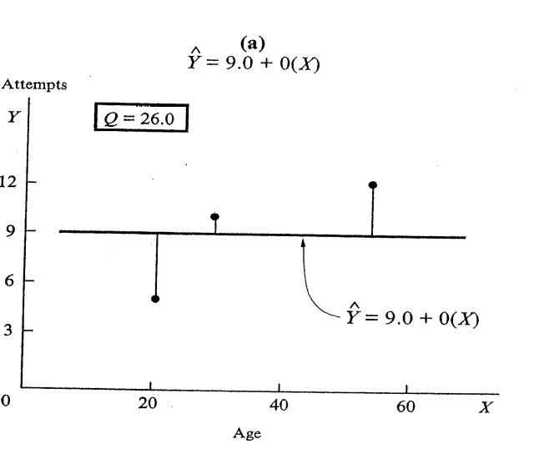

Estimation of regression function
Above is a scatter plot of the arbitrary regression line and the data. Notice this is not a very good fit, as evidenced by the large deviations of two of the observations.
Now consider a new regression line:

Slide 15
Estimation of regression function
For the first subject the deviation is
Y₁ -(b₀ + b₁X₁) = 5 – (2.81 + .177*20) = -1.35.
The sum of the squared deviations, Q, is

Slide 16
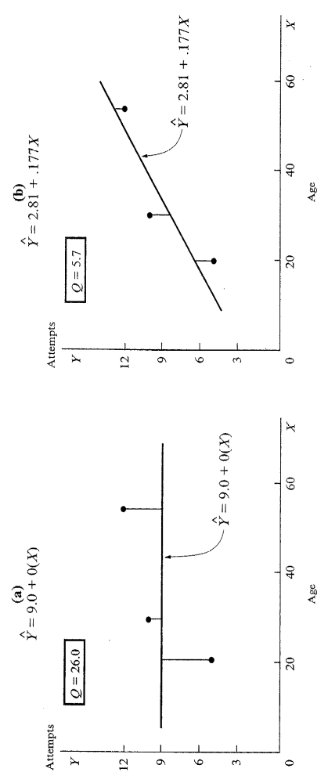
Estimation of regression function
Above is a scatter plot of the new regression line and the data. Notice this is a much better fit.
A better fit of the regression line to the data corresponds to a smaller Q.

Slide 17
Estimation of regression function
The objective of the least squares method is to find estimates b₀ and b₁ for β₀ and β₁ which minimizes Q.
Minimizing Q, minimizes the distance the observations are from the estimated values (the regression line).
The estimators b₀ and b₁ that satisfy the least squares criterion can be found in two basic ways.
1) Numerical search procedures can be used that evaluate in a systematic fashion the value of Q for different estimates b₀ and b₁ until the ones that minimize Q are found.

Slide 18
Estimation of regression function
2) Analytical procedures can often be used to find the values of b₀ and b₁ that minimize Q.
How can we find analytically the values of b₀ and b₁ that minimize Q for our simple linear regression model?
To do this, we find the partial derivatives of Q, with respect to β₀ and β₁.
We then set the partial derivatives equal to 0 and solve for b₀ and b₁, making sure the second derivative is positive.

Slide 19
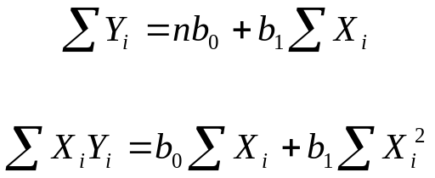
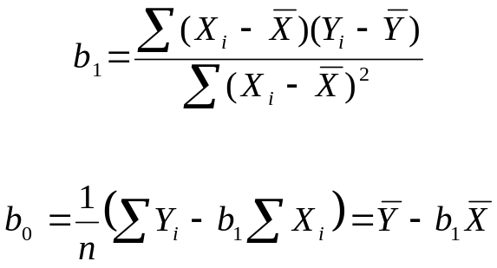
Estimation of regression function
Taking the partial derivatives and setting them to 0 gives us the normal equations
The normal equations can be solved simultaneously for b₀ and b₁ giving us our point estimators.

